Slide 1
OSI transport layer
CCNA Exploration Semester 1
Chapter 4

Slide 2
OSI transport layer
OSI model layer 4
TCP/IP model Transport layer
Application
HTTP, FTP, TFTP, SMTP etc
Presentation
Data stream
Application
Session
Transport
Segment
TCP, UDP
Transport
Network
Packet
IP
Internet
Data link
Frame
Ethernet, WAN technologies
Network Access
Physical
Bits

Slide 3
Transport layer topics
Roles of the transport layer
TCP: Transport Control Protocol
UDP: User Datagram Protocol

Slide 4
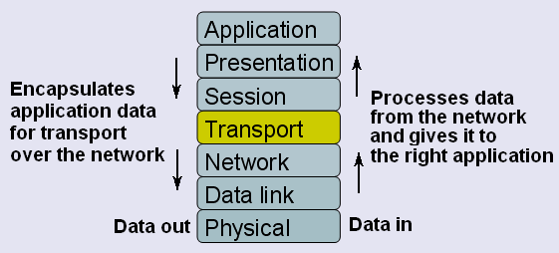
Purpose of transport layer
Responsible for the overall end-to-end transfer of application data.

Slide 5
Transport layer
Enables multiple applications on the same device to send data over the network at the same time
Provides “reliability” and error handling if required. (Checks if data has arrived and re-sends if it has not.)

Slide 6
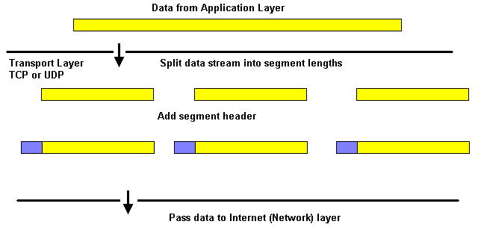
Transport Layer TCP and UDP

Slide 7
Why two transport protocols?
Some applications need their data to be complete with no errors or gaps and they can accept a slight delay to ensure this.
They use TCP.
Some applications can accept occasional errors or gaps in the data but they cannot accept any delay.
They use UDP.
Reliable
Fast

Slide 8
TCP
Sets up a connection with the receiving host before sending data.
Checks if segments have arrived and resends if they were lost. (Reliability)
Sorts segments into the right order before reassembling the data.
Sends at a speed to suit the receiving host. (Flow control)
But – this takes time and resources.

Slide 9
UDP
Connectionless. Does not contact receiving host before sending data.
Does not check if data arrived and does not re-send.
Does not sort into the right order.
“Best effort”.
Low overhead.
Used for VoIP, streaming video, DNS, TFTP

Slide 10
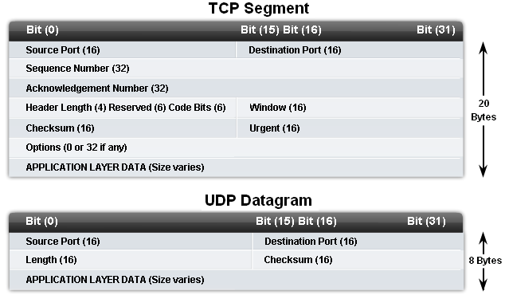
TCP and UDP headers

Slide 11
Port numbers
Used by TCP and UDP as a form of addressing.
Identifies the application and the conversation.
Common application protocols have default port numbers e.g.
80 for HTTP 110 for POP3 mail
20/21 for FTP 23 for Telnet

Slide 12
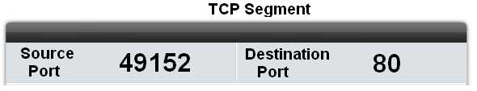
Port numbers
Client PC uses port 49152.
Chosen at random.
Remembers this to identify application and conversation.
Client PC uses port 80.
Identifies HTTP as application.
Requesting a web page.
Port + IP address = socket. E.g. 192.168.2.12:80

Slide 13
Port numbers
The Internet Assigned Numbers Authority (IANA) assigns port numbers.
Well Known Ports (0 to 1023) - Reserved for common services and applications such as HTTP, FTP, Telnet, POP3, SMTP.
Registered Ports (1024 to 49151) - Assigned to user processes or applications. Can be dynamically selected by a client as its source port.
Dynamic or Private or Ephemeral Ports (49152 to 65535) – Can be assigned dynamically to client applications when initiating a connection.

Slide 14
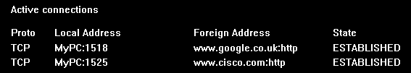
Netstat
Shows protocol, local address and port number, foreign address and port number.
Unexpected connections may mean there is a security problem.

Slide 15
Segment and sequence
Both TCP and UDP split application data into suitably sized pieces for transport and re-assemble them on arrival.
TCP has sequence numbers in the segment headers. It re-assembles segments in the right order.
UDP has no sequence numbers. It assembles datagrams in the order they arrive.

Slide 16
Connection oriented
TCP sets up a connection between end hosts before sending data
The two hosts go through a synchronization process to ensure that both hosts are ready and know the initial sequence numbers.
This process is the Three-way handshake
When data transfer is finished, the hosts send signals to end the session.

Slide 17
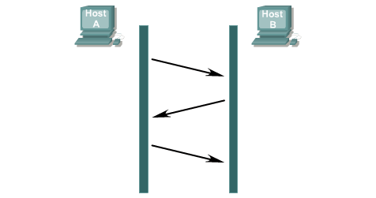
Three way handshake
Send SYN
seq = x
Receive SYN
seq = x
Send SYN
ack = y
seq = x+1
Receive SYN
ack = y
seq = x+1
Send ACK
ack = y+1
Receive ACK
ack = y+1

Slide 18
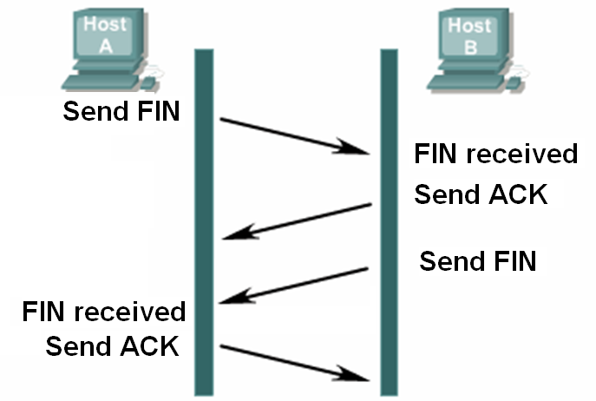
Terminating connection

Slide 19
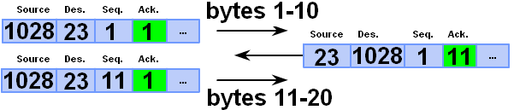
Expectational acknowledgement
TCP checks that data has been received.
The receiving host sends an acknowledgement giving the sequence number of the byte that it expects next.

Slide 20
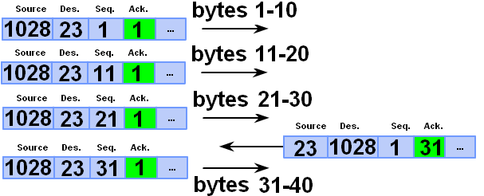
Window size
Controls how many bytes are sent before an acknowledgement is expected.

Slide 21
Lost segments
Send bytes 1 to 2999
Receive 1 to 2999, send ACK 3000
Send bytes 3000 to 4999
Receive 3000 to 3999, send ACK 4000
(bytes 4000 to 4999 were lost)
Send bytes 4000 to 5999
Lost segments are re-sent.
If no ACK – send them all again

Slide 22
Flow control
The initial window size is agreed during the three-way handshake.
If this is too much for the receiver and it loses data (e.g. buffer overflow) then it can decrease the window size.
If all is well then the receiver will increase the window size.

Slide 23
Comparison of TCP and UDP
Both TCP and UDP use port numbers
Both split up application data if necessary
TCP sets up a connection
TCP uses acknowledgements and re-sends
TCP uses flow control
TCP can re-assemble segments in the right order if they arrive out of sequence
UDP has less overhead so is faster

Slide 24
The End

